Slide 1


Microeconomics I Topic 8: Perfect Competition
Assistant Professor He Tai-Sen
ts.he@ntu.edu.sg

Slide 2
Outline
Profit maximization
Assumptions of Competitive Markets
In the short run
Individual firm’s profit maximization
Individual firm’s supply curve in the short run
Industry’s supply curve in the short run
In the long run
Individual firm’s profit maximization
Individual firm’s supply curve in the long run
Industry’s supply curve in the long run

Slide 3

Profit maximization
Economists assume that firms maximize their profit.
Profit(𝞹)=Total Revenue (TR)-Total Cost (TC)
Ex. 𝞹 =(100*q)-(200+2*q²)
The cost here refers to opportunity cost (not accounting cost)!
Ex. You run a small Café at your own commercial property.
TR = $6*1000 =$6000
TC = ($2*1000) + 2*2000 + ___________ = ____________
Notes:
4
Opportunity cost refers to what you have to give up to buy what you want in terms of other goods or services.

Slide 4
Profit maximization
First-order condition for profit maximization: MR(q)=MC(q)
Ex. 𝞹 =(100*q)-(200+2*q²)
MR(q)=________
MC(q)=________
MR(q)=MC(q) => q*= _____
The intuition behind the first-order condition:
When MR>MC, the firm can increase the profit by producing one more unit.=> not at its maximum.
When MR<MC, the firm can increase the profit by producing one less unit. => not at its maximum.
Notes:
4

Slide 5
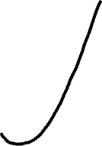

Profit maximization
Graphical analysis of the MR(q)=MC(q) condition
MR=MC=> q*
Profit when q=q*
MC
ATC
P=AR=MR
q*
Notes:
4

Slide 6
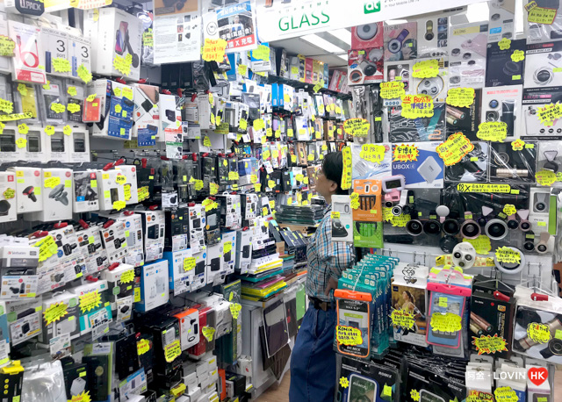
Assumptions of perfect competition
Assumptions of perfect competition:
Buyers: many buyers with zero transaction cost
Sellers: many sellers with identical cost structure; existing and potential sellers can freely enter and exit the market in the long-run
Product homogeneity: all products sold are the same
Which of the following are good examples of (nearly) perfect competition?
Cell phones
Chicken rice
Economics degrees among universities in Singapore
Bottled water
Foreign exchange
Shares of OCBC stocks
Notes:
4

Slide 7
Assumptions of perfect competition
Before we move on, I would like to remind you that our goal is to derive the market supply both in the short run and in the long run.
Short-run: at least one input is fixed.
Long-run: all inputs are variable.
Notes:
4

Slide 8
In the short run --individual firm’s profit maximization
An individual firm in a perfectly competitive market in the short-run.
An individual firm’s decision rules:
Maximize Profit=TR-TC=TR-VC-FC
Shutdown if Profit<0.
if TR cannot cover variable costs.
Ex. A taxi driver has paid $60 for the car’s rental fee. He expects that he will earn $100 in the morning shift. The costs of his time and gasoline are estimated to be $50. Should he work this morning?
If he works, his profit is ___________
If he doesn’t work, his profit is _____
FC
TR
VC
He should work even if profit is negative
Notes:
4

Slide 9
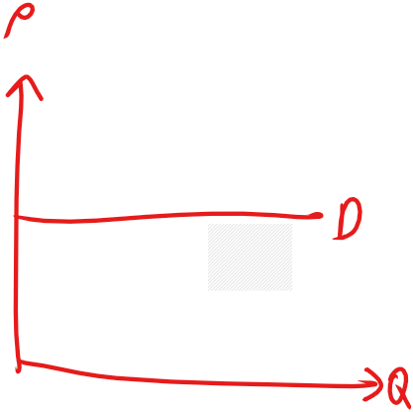
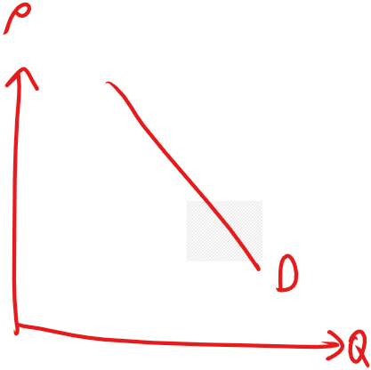
In the short run --individual firm’s profit maximization
Many sellers=>Each individual firm is a price-taker =>An individual firm face a horizontal demand curve =>P is fixed =>TR=P*q
An individual firm’s demand curve vs. the industry’s demand curve.
To summarize, Profit=TR-TC=P*q-VC(q)-FC
Notes:
4

Slide 10
In the short run --individual firm’s profit maximization
An individual firm in a perfectly competitive market in the short-run. TC=50+4q+2q²
When P=40, what quantity of output should the firm produce? Is the firm making a profit or a loss? Should the firm shut down?
When P=20, what quantity of output should the firm produce? Is the firm making a profit or a loss? Should the firm shut down?
MR = MC
40 = 4 + 4q
q* = 9
π(q=9) = (40 x 9) – (50 + 198)
= 113
2. MR = MC
20 = 4 + 4q
q* = 4
π(q=4) = (20 x 4) – (50 + 48)
= -18
FC
VC
Making a profit. Shouldn’t shut down
Making a loss. Shouldn’t shut down
Notes:
4

Slide 11

In the short run --individual firm’s profit maximization
Graphical analysis
1. Positive profit 2. Negative profit
MC
MC
ATC
ATC
AVC
AVC
profit
loss
P=AR=MR
P=AR=MR
Can cover VC
q*
q*
Notes:
4

Slide 12

In the short run --individual firm’s supply curve
An individual firm’s supply curve in the short run:
P=MC (subject to P>AVC)
MC
ATC
AVC
Supply curve
Notes:
4

Slide 13

In the short run --industry’s supply curve
The industry’s supply curve in the short run
(Market supply = Horizontal Summation)
S₁
=
MC₁
S₂
=
MC₂
a
P_{o}
b
a+b
Notes:
4

Slide 14







In the long run --individual firm profit maximization
In the long run, all inputs are variable. => no fixed cost
In the long run, existing and potential firms can freely enter and exit the market.=> zero profit condition
MC
MC
k=$k_{0}$
AC
MC
ATC
k=$k_{2}$
MC
ATC
k=$k_{1}$
MC
ATC
Notes:
4

Slide 15
In the long run --individual firm’s profit maximization
Profit maximization: similar to individual firm’s profit maximization in the short run.
MC
ATC
profit
P=AR=MR
q*
Notes:
4

Slide 16
In the long run --individual firm’s supply curve
Then, is the individual firm’s supply curve in the long-run the same as that in the short-run? The answer is NO! But, why?
Because existing and potential firms can freely enter and exit the market in the long run. Therefore, in equilibrium, all firms should make ZERO profit.
MC
MC
AC
AC
Each firm produces q at q*
P*
Supply curve
Zero Profit
q*
Notes:
4

Slide 17
In the long run --industry’s supply curve
The industry’s supply curve is a horizontal line: P=Min AC
Individual Firm
Industry
MC
AC
D
S
P_{o}
P=Min AC
Q_{o}
Q_{o}
Notes:
4

Slide 18
In the long run --industry’s supply curve (cont’d)
1) Demand ↑ Price ↑
The industry’s supply curve is a horizontal line: P=Min AC
Individual Firm
Industry
D’
MC
AC
D
S
P₁
P₁
P_{o}
P=Min AC
Q_{o}
Q_{o}
Notes:
4

Slide 19
In the long run --industry’s supply curve (cont’d)
1) Demand ↑ Price ↑ More firms join 2) Supply ↑ Price ↓ until equilibrium
The industry’s supply curve is a horizontal line: P=Min AC
Individual Firm
Industry
D’
MC
AC
D
S
S’
P₁
P₁
P_{o}
P=Min AC=LS
Q₁
Q_{o}
Q₁
Q_{o}
Notes:
4

Slide 20
In the long run --the industry’s supply curve
However, we implicitly assume that input prices are fixed.
Case 1: If input prices increase with quantity, then the industry’s supply curve in the long run would be upward-sloping.
Notes:
4

Slide 21
In the long run --industry’s supply curve
Individual Firm
Industry
AC
D
S
MC
P_{o}
P_{o}
Q_{o}
Q_{o}
Notes:
4

Slide 22
In the long run --industry’s supply curve (cont’d)
Individual Firm
Industry
MC’
AC’
D’
AC
D
S
MC
P₁
P₁
P_{o}
P_{o}
Q_{o}
Q_{o}
Q₁
Notes:
4

Slide 23
In the long run --industry’s supply curve (cont’d)
Individual Firm
Industry
MC’
AC’
D’
AC
D
S
MC
S’
P₁
P₁
P₂
P₂
P_{o}
P_{o}
Q₂
Q₂
Q_{o}
Q_{o}
Q₁
Notes:
4

Slide 24
In the long run --industry’s supply curve (cont’d)
Individual Firm
Industry
MC’
AC’
D’
AC
D
S
MC
S’
LS
P₁
P₁
P₂
P₂
P_{o}
P_{o}
Q₂
Q₂
Q_{o}
Q_{o}
Q₁
Notes:
4

Slide 25
In the long run --the industry’s supply curve
However, we implicitly assume that input prices are fixed.
Case 2: If input prices decrease with quantity, then the industry’s supply curve in the long run would be downward-sloping.
Notes:
4

Slide 26
In the long run --industry’s supply curve (cont’d)
Individual Firm
Industry
MC
AC
D
S
P_{o}
P_{o}
Q_{o}
Q_{o}
Notes:
4

Slide 27
In the long run --industry’s supply curve (cont’d)
Individual Firm
Industry
D’
MC
AC
D
S
MC’
P₁
AC’
P₁
P_{o}
P_{o}
Q_{o}
Q_{o}
Q₁
Notes:
4

Slide 28
In the long run --industry’s supply curve (cont’d)
Individual Firm
Industry
D’
MC
AC
D
S
MC’
P₁
AC’
S’
P₁
P_{o}
P_{o}
P₂
P₂
Q_{o}
Q₂
Q_{o}
Q₁
Q₂
Notes:
4

Slide 29
In the long run --industry’s supply curve (cont’d)
Individual Firm
Industry
D’
MC
AC
D
S
MC’
P₁
AC’
S’
P₁
P_{o}
P_{o}
P₂
P₂
LS
Q_{o}
Q₂
Q_{o}
Q₁
Q₂
Notes:
4

Slide 30
A Note on the welfare analysis of perfect competition
Social Welfare = Consumer Surplus + Producer Surplus
The competitive equilibrium maximizes social welfare.
D
Among all possible Q, Q^{c}
maximize social welfare
S
C.S
P^{c}
P.S
Q^{c}
Notes:
4

Slide 31
A Note on the welfare analysis of perfect competition
Please watch: Adam Smith: The Invisible Hand and The Invisible Hand - Full Video
Notes:
4

